Slide 1
Mushroom Classifier…

Slide 2
Objective:
Development of a predictive classification model for mushroom types:
Detection of mushroom class
Easy to classify

Slide 3
Data :
Number of Columns
Column names
Column data type

Slide 4
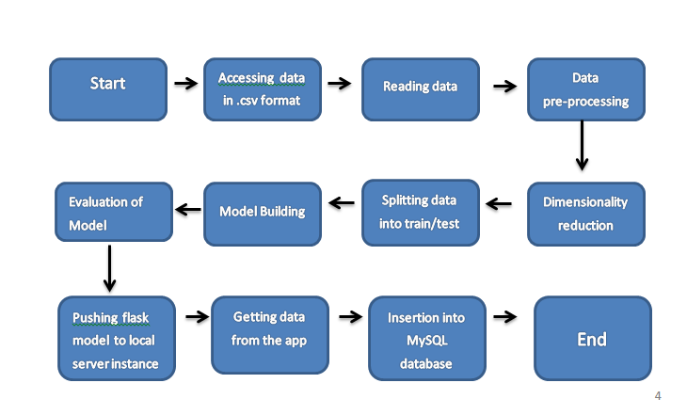
Architecture

Slide 5
Data Validation and Data Transformation :
Name Validation – Validation of the file using the pandas read.
Number of Columns – Validation of number of columns present in the .csv files, and if it doesn't meet the specification then the file is removed.
Name of Columns - The name of the columns is validated and should be the same as given in the schema file. If not, file to discarded.
Data type of columns - The data type of columns is given in the schema file. It is validated when we insert the files into Database. If the datatype is wrong, then the file is moved to recycle
Null values in columns - If any of the columns in a file have all the values as NULL or missing, we discard such a file discarded…

Slide 6
Model Training:
Data Import from local memory :
The accumulated data from memory is exported in csv format for model training
Data Preprocessing
Performing EDA to get insight of data like identifying distribution , outliers ,trend
among data etc.
Check for null values in the columns. If present impute the null values.
Encode the categorical values with numeric values.
Perform one hot encoding.
Use the lasso model for the feature selection.

Slide 7
Model Selection –
Deploying as many number of models as possible like
- Logistic Regression, Naive Bayes, SVC, KNN, Decision Tree, Random forest, SGD Classifier, Ada Boost, XG boost, Gradient boost.
- Use GridsearchCV to hyper tune the models.
- By using the ensemble technique (voting classifier) we ensemble all the best resulted models.
- Use the voting classifier as the final model, train and evaluate the model using classification report or accuracy score or confusion matrix.

Slide 8
Prediction:
The testing files are shared in the batches and we perform the same Validation operations ,data transformation and data insertion on them.
The accumulated data from local file system is exported in csv format for prediction
We perform data pre-processing techniques on it.
Voting classifier model created during training is loaded for the preprocessed data is predicted
Once the prediction is done for all the testing data. The predictions are saved in csv format and shared.

Slide 9
Data Insertion in Database:
Table creation :- Table name “predictions" is created in the database for inserting the files. If the table is already present then new files are inserted in the same table.
Insertion of files in the table - All the files in the user interface are to be inserted along with the prediction result in the above-created table.

Slide 10
Q & A:
Q1) What’s the source of data?
The data for training is provided by the client in csv format
Q 2) What was the type of data?
The data was the combination of numerical and Categorical values.

Slide 11
Q 3) How logs are managed?
We are using different logs as per the steps that we follow in validation and
modeling like File validation log , Data Insertion ,Model Training log , prediction log
etc.
Q 4) What techniques were you using for data pre-processing?
Dropping unwanted columns
Visualizing relation of independent variables with each other and output variables
Cleaning data and imputing if null values are present in the data(not present).
Converting categorical data into one hot representation values.

Slide 12
Q 5) How training was done or what models were used?
Divide the data to training and validation data.
Algorithms like Logistic Regression, Naive Bayes, SVC, KNN, Decision Tree, Random forest, SGD Classifier, Ada Boost, XG boost, Gradient boost were used to build the best ensemble model. final model was saved .
Q 6) How Prediction was done?
The testing files are shared by the user .We Perform the same life cycle till the data preprocessing. In the end we get the accumulated data of predictions.

Slide 13
Q 7) What are the different stages of deployment?
When the model is ready we deploy it in local environment or Render, AWS, GCP or Azure .(Here used both local environment and render webhosting .)
Host Address : https://mushroom-lite.onrender.com

